Slide 1
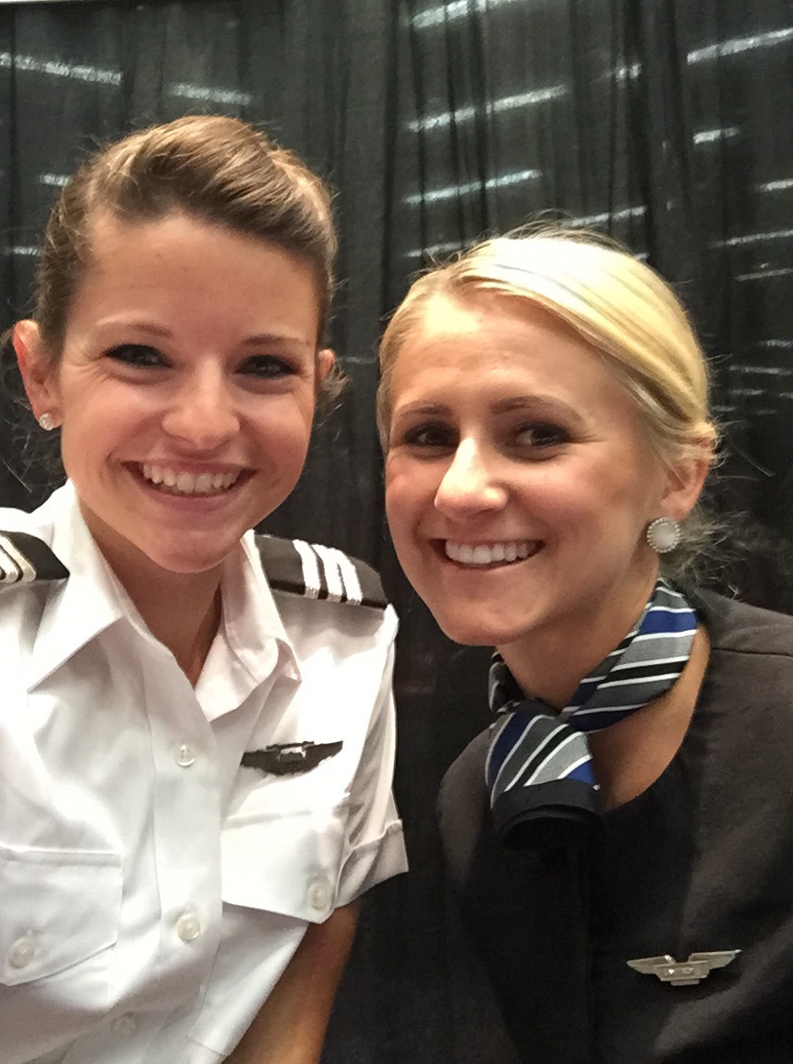
Welcome to the 2017 ATC Advisory Meeting!

Slide 2
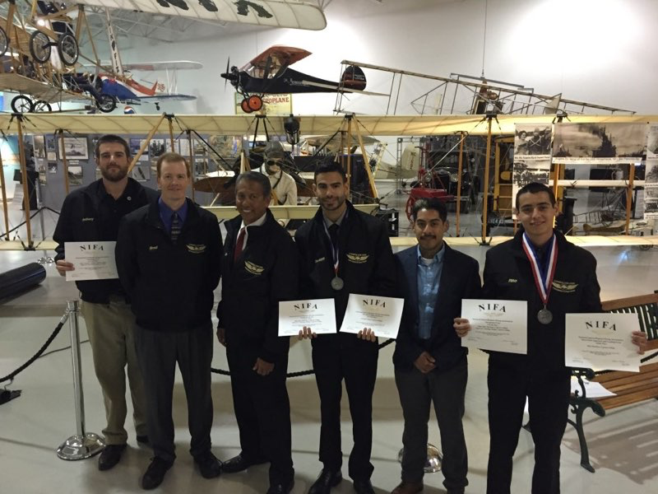
Flying Team Competition

Slide 3
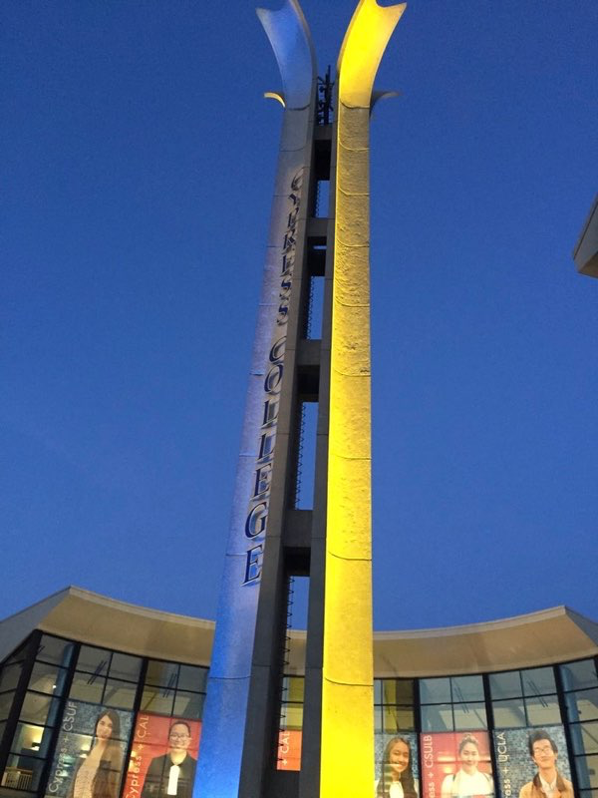
Purpose of the Advisory Committee
To gather recommendations about the following:
Hiring
Skill Requirements
Internships
Career Opportunities
Latest Technologies
Equipment & Facilities
New Developments or Issues

Slide 4
Total Certificate / Degree Awards (Since Tracking Began. F14-S16 Reduced Application Period)

Slide 5
Annual Enrollments

Slide 6
Student Equity Percentage of Students with a “C” or Better: F15 thru S16

Slide 7
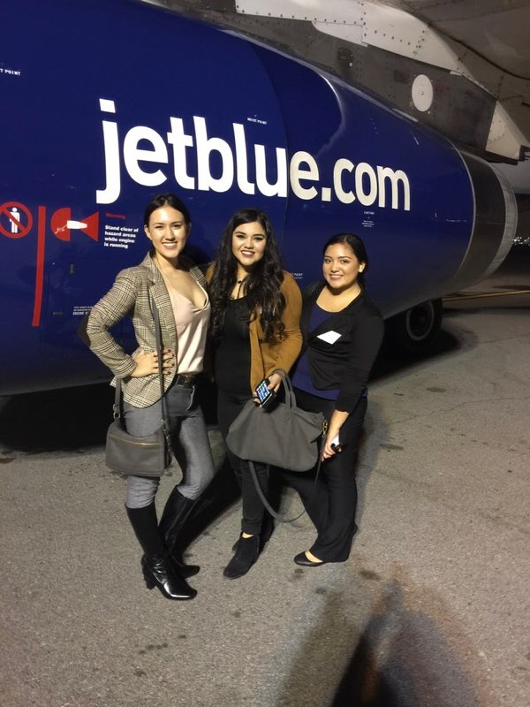
Job Growth: Flight Attendants +20% Pilots +19% Travel Agent + 9% Airline CSAs +13% Source: O*NET 2017

Slide 8
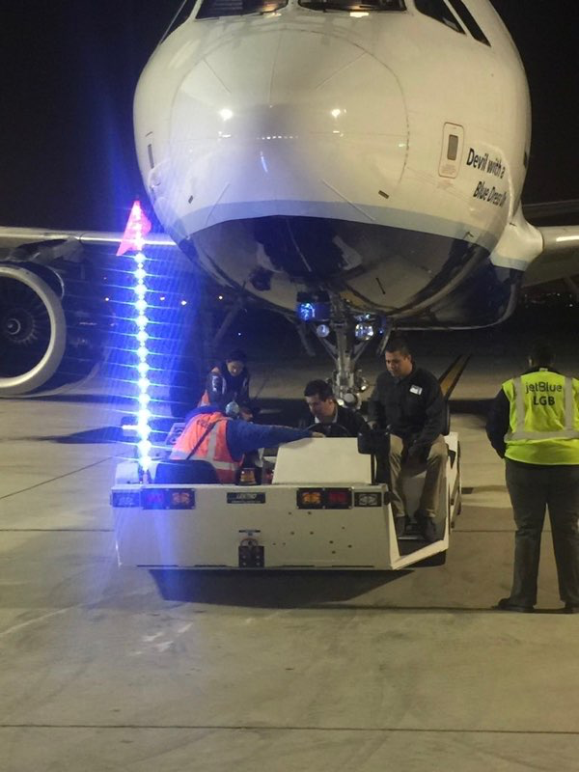
Curriculum
UAV / UAS Certificates+Degree
AS Degrees (CSU GE + 21 ATC)
CTE Aviation
CTE Homeland Security
CTE Tourism
AST Administration of Justice

Slide 9
Perkins Grant: Total $769,354 $70,500 for 2008-09 $87,350 for 2009-10 $87,754 for 2010-11 $79,722 for 2011-12 $81,328 for 2012-13 $84,115 for 2013-14 $90,671 for 2014-15 $80,014 for 2015-16 $108,900 for 2016-17
Cypress College
~Aviation & Travel Careers
~Homeland Transportation Security
–Cruise Line Sales & Ops
Career Technical Education
Industry
~Airlines
~Travel Companies (Disney, cruise, agencies)
~Flight Safety International
~Flight Schools
Workforce Development Strategies
Aviation / Travel Collaborative
~Two-year Colleges (CC, OCC, LBCC, Mt. Sac)
~Four-year Colleges (CSU LA, USC, SIU)
~High Schools, ROP
~Industry
Industry/Education Collaboration
Outreach
~High Schools
~Middle Schools
~Dual Enrollment
~Non-traditional
~Online
~ROP
Career Days (displays, wings)
Outreach Packages
Advisory Boards
Resources
Conferences
"Joy Ride" in Flight Simulator
Interactive Website
Flight Safety Workshops
Paper Airplane Design & Contest
Internships
Service Learning
Job Placement Website
Equipment and Outreach Materials
Government Initiatives
Career Paths
Curriculum Improvements
Articulation
Certificates & Degrees
Portfolio Assessment
Career Paths for High-pay, High Technology Aviation Careers
Access to Advanced Technologies
Computer Based Training

Slide 10
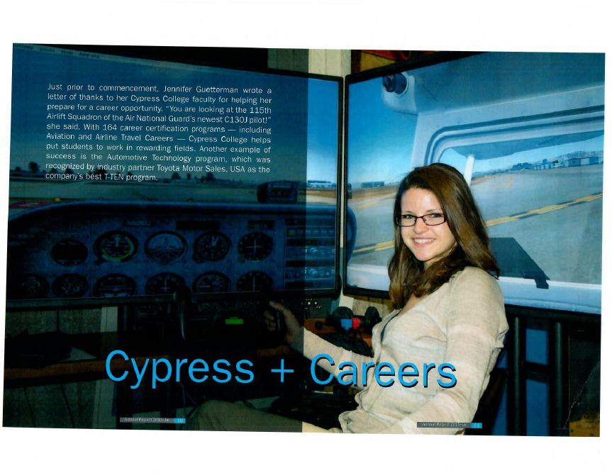
Thank you!

